Slide 1
2024 Election Results Analysis Comprehensive Insights and Trends
-Pooja Preethi Mugan

Slide 2
Agenda
Introduction
Data Overview
Key Findings
Interactive Dashboard Demonstration
Insights and Recommendations

Slide 3
Introduction
Brief overview of the 2024 election and the importance of analyzing the results.
Objectives of the analysis:
Gain insights into election results.
Understand party and alliance performance.
Identify voter trends across constituencies.

Slide 4
Data Overview
Election Results Data:
_id, State,
Const. No., Constituency
Leading Candidate
Leading Party
Trailing Candidate
Trailing Party
Margin
Status
Party Alliance Data:
Party Name
Alliance Name.

Slide 5
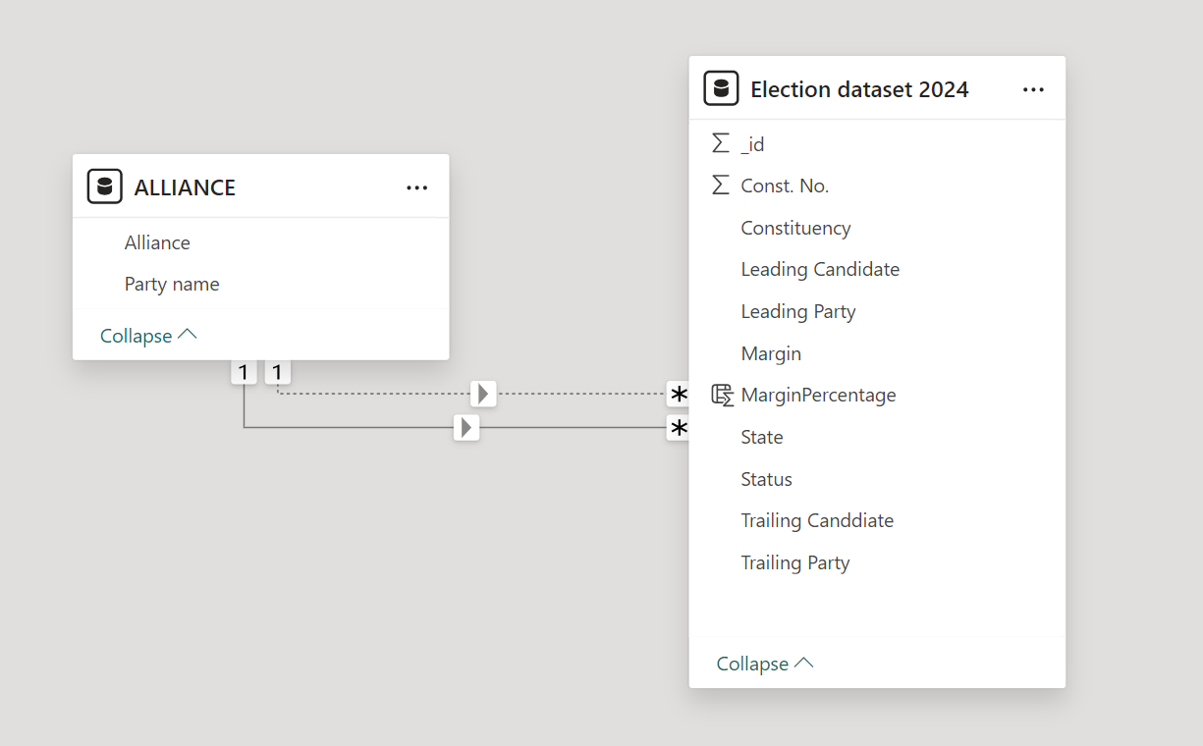
Data Integration and Preparation
Steps taken to combine and
clean the datasets.
Null value are treaded as 0.

Slide 6
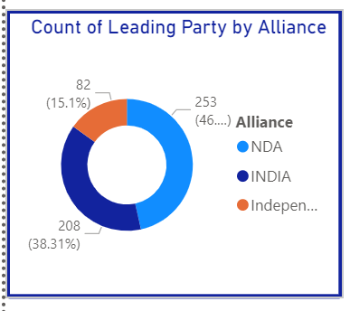
Key Findings - Overall Results
Visual 1: Donut chart of leading party by alliance
Description of the distribution of leading parties by their alliances.

Slide 7
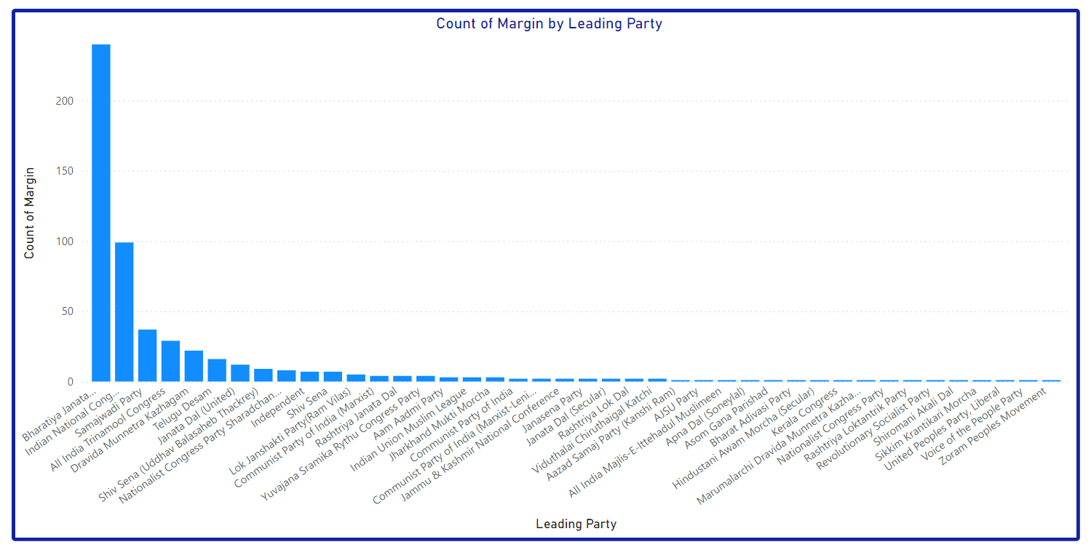
Key Findings - Total Seats Won by Party
Visual 2: Bar graph of total seats won by party

Slide 8
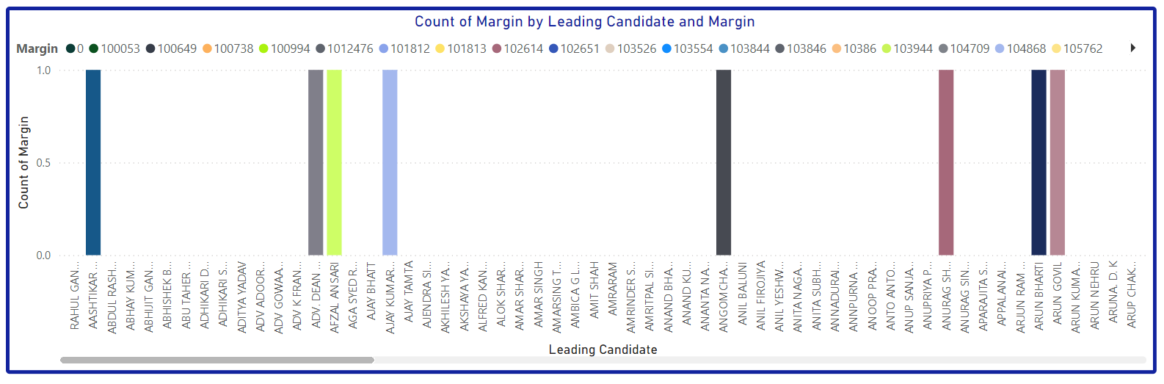
Key Findings - Leading Candidates and their Margins
Visual 3: Bar graph of leading candidates and their margins

Slide 9
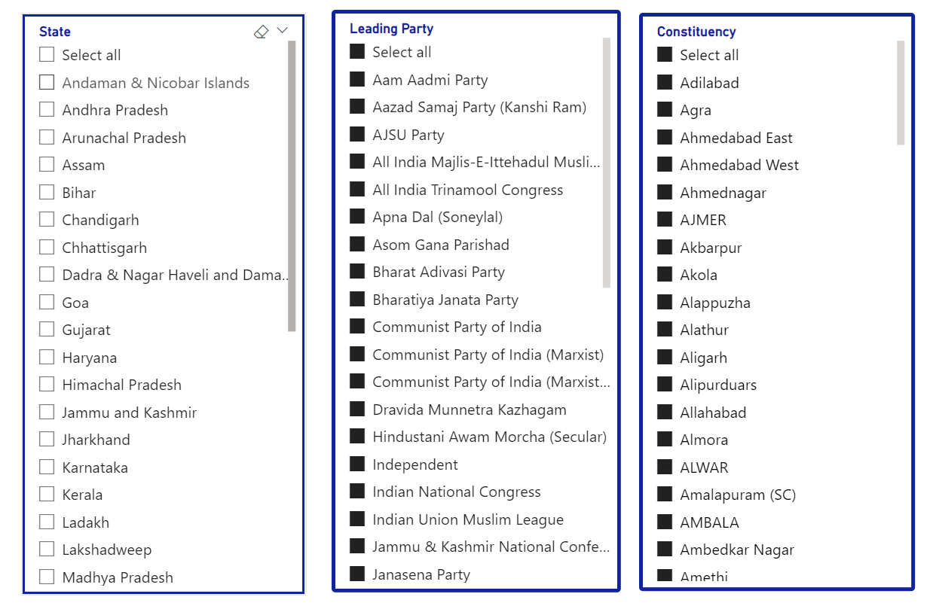
Interactive Elements in Dashboard
Explanation of slicers for state, constituency, and party-wise filtering.

Slide 10
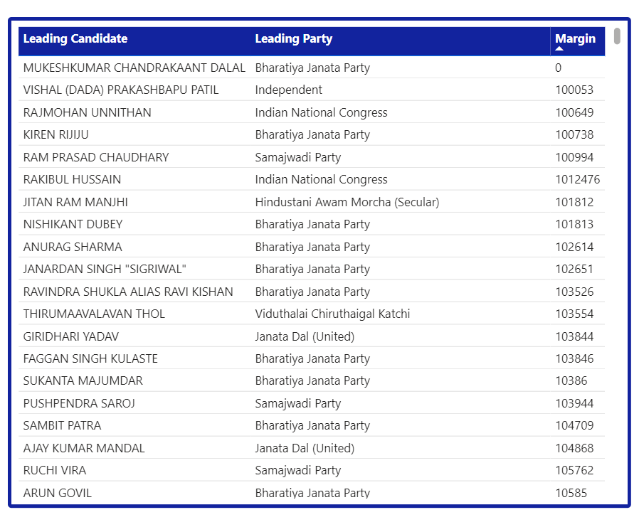
Table of Leading Candidates
Table representing leading candidates' names, party names, and margins

Slide 11
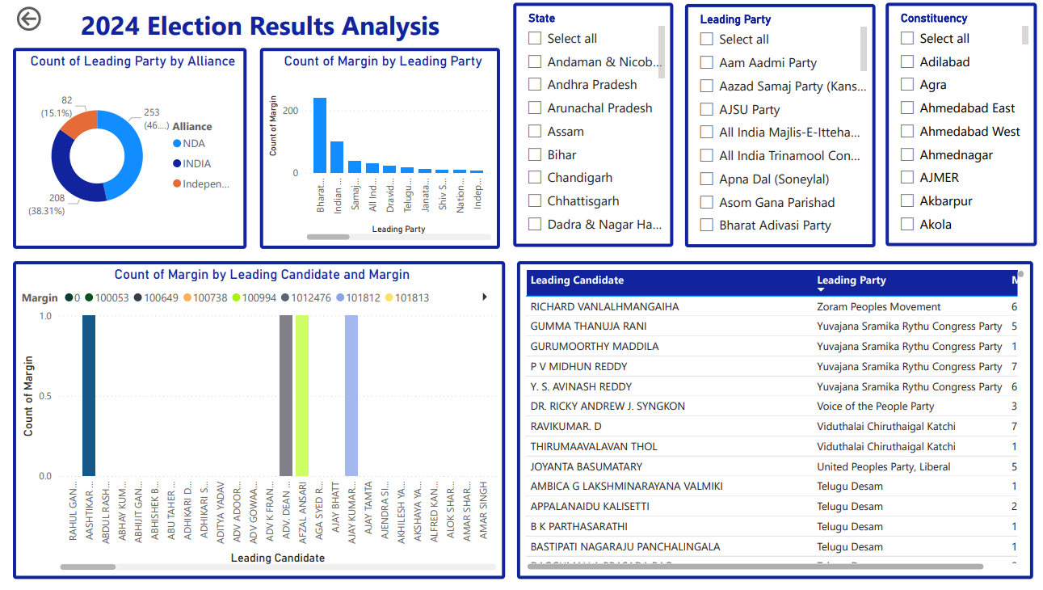
Interactive Dashboard Demonstration

Slide 12
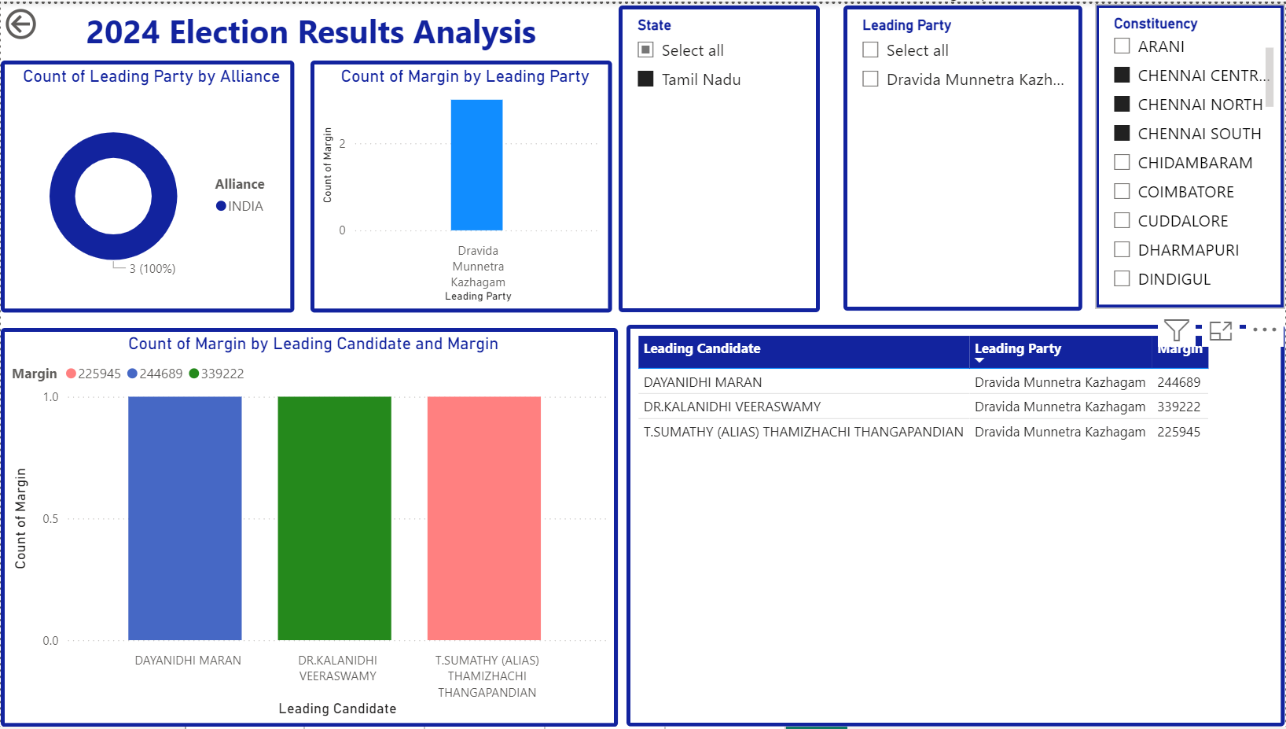
Analyzing Chennai Election Results

Slide 13

Thank You
-Pooja Preethi Mugan
Source Code: dashboard
Dataset: folder
Mail: mppm167@gmail.com

